Slide 1



From dumb to smarter switches in software defined networks: an overview of data plane evolution
IEEE CAMAD 2014 – Athens, 1-3 December
Giuseppe Bianchi
University of Rome “Tor Vergata”
Antonio Capone
Politecnico di Milano - ANTLab

Slide 2
Agenda
Setting the scene: a brief intro to SDN and OpenFlow
Switches cannot remain dumb: Starting the process of data plane evolution
Not too much not too little: OpenState and statefull data planes
Applied smartness: statefull applications

Slide 3
Setting the scene: a brief intro to SDN and OpenFlow
The future has already arrived. It's just not evenly distributed yet. [William Gibson]

Slide 4
Classic network paradigm
Distributed network functions
State distribution mechanism (protocols)
OS
Forwarding HW
OS
OS
Forwarding HW
Forwarding HW
Router/switch/appliance

Slide 5
Vertically integrated
L3 Routing, L2 switching, ACL, VPNs, etc…
App
App
App
Closed platform!
Control-plane
OS
Forwarding HW
Data-plane
Protocols guarantee interoperability… But what’s the drawback?
Notes:
Closed platform
HW, OS and apps usually proprietary and implemented by the same vendor
Interoperability trough standard protocols

Slide 6
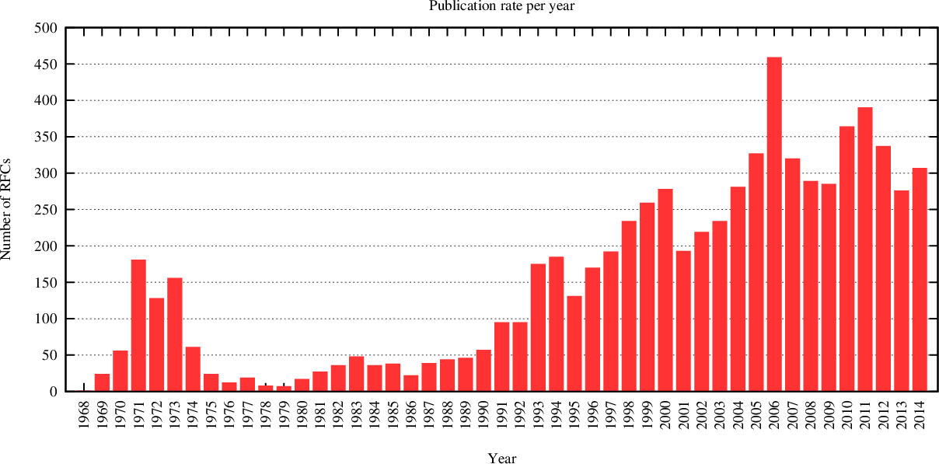
Way too many standards?
Source: IETF
Notes:
Way too many standard too comply with…

Slide 7


Slide 8
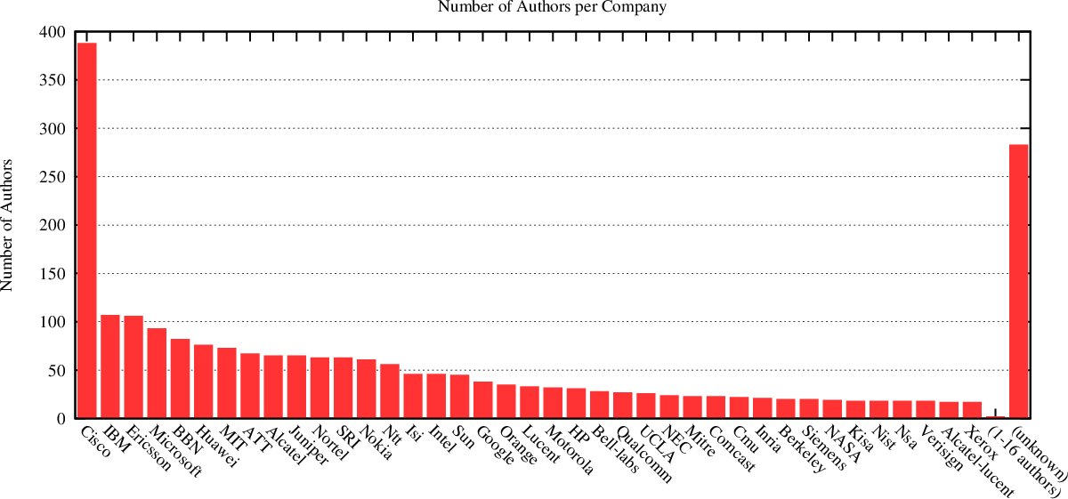
Vendors dominated?
Source: IETF

Slide 9
Non-standard management
Configuration interfaces vary across:
Different vendors
Different devices of same vendor
Different firmware versions of same device!
SNMP fail
Proliferation of non-standard MIBs
Partially implemented standard MIBS
IETF recently published a recommendation to stop producing writable MIB modules

Slide 10
The (new) paradigm
Traditional networking
Software-Defined Networking
Switch
Programmable switch
Control-plane
Control-plane
Data-plane
Control-plane
Data-plane
Data-plane
Data-plane
Control-plane
Data-plane
Data-plane

Slide 11
SDN architecture
App
App
App
Network control API
Network OS
HW open interface
Simple forwarding HW
Simple forwarding HW
Simple forwarding HW
Simple forwarding HW

Slide 12
From protocols to API
HW forwarding abstraction
low-level primitives to describe packet forwarding
Control plane API
Network topology abstraction
High-level access to switch programming
Common libraries
Host tracking
Shortest-path
Etc..

Slide 13
Success keys
Low-level HW open interface
Good, extensible and possibly open-source Network OS
Open market for third-party network application developers
Network app store
Several attempts (Active Networks, IETF ForCES), but one winner …

Slide 14

OpenFlow
Stanford, 2008
Clean Slate research program
“With what we know today, if we were to start again with a clean slate, how would we design a global communications infrastructure?”
Is it really a clean slate approach?

Slide 15
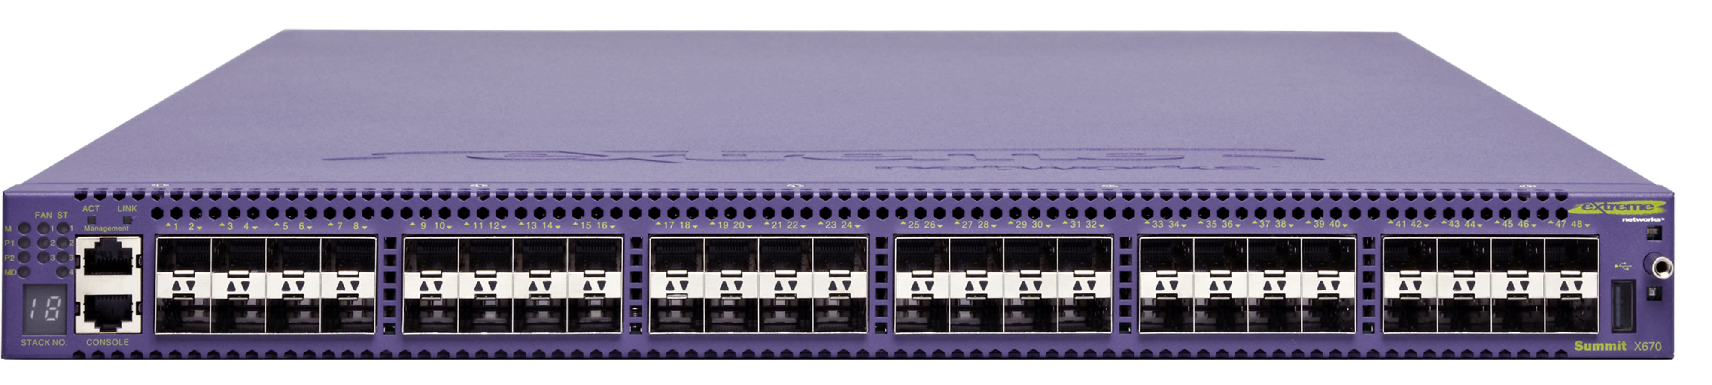
OpenFlow
OpenFlow is actually a pragmatic approach to SDN based on a simple HW abstraction that can be implemented with current HW commercial platforms
OpenFlow controller
OpenFlow Protocol (SSL/TCP)
In-bound or out-bound

Slide 16
What is OpenFlow
Switch abstraction
Match/action flow table
Flow counters
It doesn’t describe how this should be implemented in switches (vendor neutral !!!)
Application layer protocol
Binary wire protocol, messages to program the flow table
Transport protocol
TCP, TLS

Slide 17
Flow table
Match
Actions
Counters
Bytes + packets
Forward (one or more ports)
Drop
Encapsulate and send to controller
Header rewrite
Push/pop MPLS label / VLAN tag
Queues + bitrate limiter (bit/s)
Etc..
Switch
Port
VLAN
ID
VLAN
pcp
MAC
src
MAC
dst
Eth
type
IP
Src
IP
Dst
IP
ToS
IP
Prot
L4
sport
L4
dport
Slide courtesy: Rob Sherwood

Slide 18
Switch abstraction
OpenFlow controller
Software
OpenFlow client
Hardware (e.g. TCAM) or software
Flow table (aka Forwarding Information Base)

Slide 19
Example
Description | Port | MAC src | MAC dst | Eth type | VLAN ID | IP Src | IP Dest | TCP sport | TCP dport | Action
L2 switching | * | * | 00:1f:.. | * | * | * | * | * | * | Port6
L3 routing | * | * | * | * | * | * | 5.6.*.* | * | * | Port6
Micro-flow handling | 3 | 00:20.. | 00:1f.. | 0x800 | Vlan1 | 1.2.3.4 | 5.6.7.8 | 4 | 17264 | Port4
Firewall | * | * | * | * | * | * | * | * | 22 | Drop
VLAN switching | * | * | 00:1f.. | * | Vlan1 | * | * | * | * | Port6, port7, port8

Slide 20
Reactive vs Proactive
Reactive
Start with flow table empty
First packet of a flow sent to controller
Controller install flow entries
Good for stateful forwarding:
L2 switching, dynamic firewall, resource management
Proactive
Flow entries installed at switch boot
Good for stateless forwarding:
L3 routing, static firewall, etc..

Slide 21
OpenFlow 1.0 recap
Redirect to controller
Flow table
Packet
Apply actions, forward
Drop
Notes:
Too simple
Lossy abstraction

Slide 22
Models can be perfect and clean, reality is dirty!
The match/action model can ideally be used to program any network behavior and to get rid of protocol limitations at any level
But unfortunately, with OF:
Matches can be done only on a set of predefined header fields (Ethernet, IPv4, MPLS, VLAN tag, etc.)
Actions are limited to a rather small set
Header manipulation (like adding label/tags, rewriting of fields, etc.) is limited to standard schemes
As a result, OF is not really protocol independent and standards (including OF standards) are still necessary

Slide 23
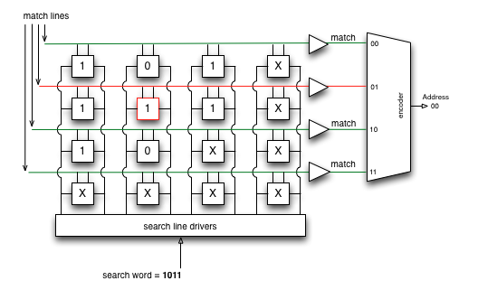
Where do OF limitations come from?
OpenFlow has been designed having in mind current specialized HW architecture for switches
Specialized HW is still fundamental in networking
General purpose HW (CPU) and soft-switches are still 2 order of magnitude slower
Architectures based network processors are also at least 1 order of magnitude slower
The reference HW model for OF flow tables is TCAM (Ternary Content Addressable Memory)
Redirect to controller
Flow table
(TCAM)
Packet
Actions
Drop

Slide 24
Where do OF limitations come from?
TCAMs however are typically expensive components that are used by manufacturers only when strictly necessary
Less expensive memory components based on predefined search keys are often used for most of the common functions of a switch
OF success depends on its “vendor neutral” approach where implementations issues are completely opaque (including reuse of standard modules for e.g. MAC and IP forwarding)
Specialized ASICs are typically complex with a number of hard limitations on table types, sizes, and match depth

Slide 25
Switches cannot remain dumb: Starting the process of data plane evolution
One man alone can be pretty dumb sometimes, but for real bona fide stupidity, there ain't nothin' can beat teamwork. [Edward Abbey]

Slide 26
Evolution of the AL in OpenFlow: OF 1.1
Single tables are costly: all possible combinations of header values in a single long table
Solution: Multiple Match Tables (MMT)
New actions:
Add metadata: parameters added and passed to next table
Goto table: possibility to go to specific tables for further processing
Notes:
The new group abstraction enables OpenFlow to represent a set of ports as a single entity for forwarding
packets. Different types of groups are provided, to represent different abstractions such as multicasting or
multipathing.

Slide 27
Evolution of the AL in OpenFlow: OF 1.1
Packets of the same flow are applied the same actions unless the table entry is modified by the controller
Not good for some common and important cases (e.g. multicast, multipath load balancing, failure reaction, etc.)
Solution: Group tables
Goto table “group table n”
List of buckets of actions
All or some of the buckets are executed depending on the type
Types of Group tables
All (multicast)
Select (multipath)
Fast-failover (protection switching)
Notes:
The new group abstraction enables OpenFlow to represent a set of ports as a single entity for forwarding
packets. Different types of groups are provided, to represent different abstractions such as multicasting or
multipathing.

Slide 28
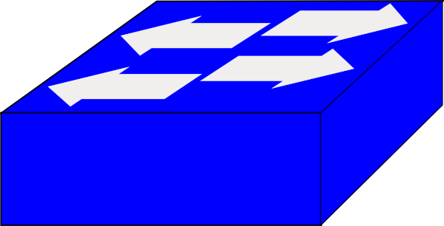
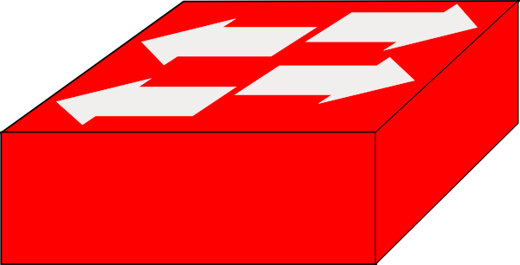
Evolution of the AL in OpenFlow: OF 1.1
Fast failover
Note that this is the first “stateful” behavior in the data plane introduced in OF !!!
Port A
Group table
fast failover
Status monitoring
Action bucket 1:
FWD Port A, …
Port B
Action bucket 2:
FWD Port B, …
Status monitoring
Action bucket 3:
FWD Port C, …
Port C
A
B
Action bucket 4:
FWD Port D, …
Status monitoring
D
C
Port D
Status monitoring
Notes:
The new group abstraction enables OpenFlow to represent a set of ports as a single entity for forwarding
packets. Different types of groups are provided, to represent different abstractions such as multicasting or
multipathing.

Slide 29
Evolution of the AL in OpenFlow: OF 1.2
Support for IPv6, new match fields:
source address, destination address, protocol number, traffic class, ICMPv6 type, ICMPv6 code, IPv6 neighbor discovery header fields, and IPv6 flow labels
Extensible match (Type Length Value)
Experimenter extensions
Full VLAN and MPLS support
Multiple controllers
Notes:
Type Length Value allow greater flexibility for the treatment of current and future
Protocols.
Experimentere extensions introduce dedicated fields and code points (assigned by ONF) for the implementation of extensions to the OpenFlow protocol

Slide 30
Evolution of the AL in OpenFlow: OF 1.3
Initial traffic shaping and QoS support
Meters: tables (accessed as usual with “goto table”) for collecting statistics on traffic flows and applying rate-limiters
Meter Table
Meter indentifier | Meter band | Counters
… | … | …
… | … | …
… | … | …
Type | Rate | Counters | Type/argument

Slide 31
Evolution of the AL in OpenFlow: OF 1.3
More extensible wire protocol
Synchronized tables
tables with synchronized flow entries
Bundles
similar to transactional updates in DB
Support for optical ports

Slide 32
Next OF: discussion started
Within ONF
Tunnel support
L4-L7 service support
Error handling
Fitness for carrier use
Support for OAM in its various forms
Flow state (…)

Slide 33
Next OF: discussion started
Flow state
The capability to store / access flow metadata that persists for lifetime of flow (not just current packet)
Potential to enable a variety of new capabilities:
Fragment handling without reassembly
Relation between bidirectional flows (e.g., RDI)
Autonomous flow learning + flow state tracking
MAC learning
TCP proxy
Hierarchies of flows
e.g. FTP control / data, all belonging to a user, etc.
[MAC13] Ben Mack-Crane, “OpenFlow Extensions”, US Ignite ONF GENI workshop, Oct 2013

Slide 34

Also abstraction “involutions” (?): Typed tables
“A step back to ensure wider applicability”
A third way between reactive and proactive
Pre-run-time description of switch-level “behavioral abstraction” (tell to the switch which types of flowmods will be instantiated at run time)
Limit types supported according to HW type
Typed tables patterns: Forwarding Elements (F:E.)
OpenFlow 1.0
Layer 3 IPv4
Statefull Generic Tunnel
802.1D Forwarding
(…)
Stateless Generic Tunnel
Constrained OpenFlow 1.1
ONF Forwarding Abstractions WG

Slide 35
Further flexibility limitations due to specialized HW
OF introduced the MMT model but does not mandate the width, depth, or even the number of tables
OF allows the introduction of new match fields through a user-defined field facility
But existing switch chips implement a small (4–8) number of tables whose widths, depths, and execution order are set when the chip is fabricated.
This severely limits flexibility through specialized chips:
Chip for core routers: large 32-bit IP longest matching table and a small 128 bit ACL match table
Chip for enterprise router: small 32-bit IP table and large ACL table, with an additional MAC address match tables
[BOS13] P. Bosshart, G. Gibb, H.-S. Kim, G. Varghese, N. McKeown, M. Izzard, F. Mujica, and M. Horowitz, “Forwarding metamorphosis: Fast programmable match-action processing in hardware for sdn”, in ACM SIGCOMM 2013.

Slide 36
Reconfigurable Match Tables (RMT)
Recent proposal by McKeown, Varghese et al. [BOS13]
RMT
Field definitions can be altered and new fields added
Number, topology, widths, and depths of match tables can be specified, subject only to an overall resource limit on the number of matched bits
New actions may be defined
Arbitrarily modified packets can be placed in specified queues, for output at any subset of ports, with a queuing discipline specified for each queue.
[BOS13] P. Bosshart, G. Gibb, H.-S. Kim, G. Varghese, N. McKeown, M. Izzard, F. Mujica, and M. Horowitz, “Forwarding metamorphosis: Fast programmable match-action processing in hardware for sdn”, in ACM SIGCOMM 2013.

Slide 37
Reconfigurable Match Tables (RMT)
Global states
Programmable parser
Header re-write with very long instruction word (VLIW)
Configurable queues
Physical flexible architecture on chip
[BOS13] P. Bosshart, G. Gibb, H.-S. Kim, G. Varghese, N. McKeown, M. Izzard, F. Mujica, and M. Horowitz, “Forwarding metamorphosis: Fast programmable match-action processing in hardware for sdn”, in ACM SIGCOMM 2013.

Slide 38
All the way down to programmability: P4
Recent “strawman proposal” by McKeown, Rexford et al. [BOS13b]
Towards real protocol independence:
No predefined fields, but reconfigurable fields
Protocol independence, switches not be tied to any specific network protocols
Target independence: flexible packet-processing functionality independently of the specifics of the underlying hardware.
Advanced “configurability”
[BOS13b] P. Bosshart, D. Daly, M. Izzard, N. McKeown, J. Rexford, D. Talayco, A. Vahdat, G. Varghese, D. Walker, “P4: Programming protocol-independent packet processors,” arXiv:1312.1719.

Slide 39
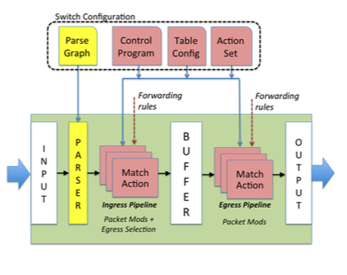
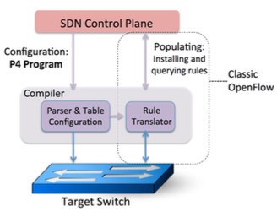
All the way down to programmability: P4
Configurability achieved with a programming language describing parsing and control
Programs are “compiled” according to the specific specialized HW
[BOS13b] P. Bosshart, D. Daly, M. Izzard, N. McKeown, J. Rexford, D. Talayco, A. Vahdat, G. Varghese, D. Walker, “P4: Programming protocol-independent packet processors,” arXiv:1312.1719.

Slide 40
Protocol Oblivious Forwarding (POF)
Removing/neglecting constraints on general HW can lead to extreme flexibility of a clean slate approach (not in the OF evolution track)
POF proposal by Huawei [SON13]
POF makes the forwarding plane totally protocol-oblivious
The POF FE has no need to understand the packet format.
POF FE execute instruction of its controller to:
extract and assemble the search keys from the packet header,
conduct the table lookups,
execute the associated instructions (in the form of executable code written in FIS or compiled from FIS).
[SON13] H. Song, “Protocol-oblivious forwarding: Unleash the power of SDN through a future-proof forwarding plane, HotSDN ’13. ACM, 2013, pp. 127–132.

Slide 41
Tiny programs in the packets
Taking programmability to the extreme …
Remember “active networks” …
[JEY13] V. Jeyakumar, M. Alizadeh, C. Kim, and D. Mazieres, “Tiny packet programs for low-latency network control and monitoring,”. HotSDN ’13

Slide 42
Deeply Programmable Networks (FLARE)
Fully programmable control plane
Fully programmable data plane
Flexible and extensible API for both planes
Experimental implementation
Aki Nakao, FLARE Project, NakaoLab, The university of Tokyo.

Slide 43
Not too much not too little: OpenState and stateful data planes
Too clever is dumb.
[Ogden Nash]

Slide 44

Looking for the “right” abstraction
Programmability and real world viability
High levels of (deep) programmability in the data and control planes since ages
Active Networks
IETF ForCES
Keywords for success:
Pragmatism
Compromise
“right” mix of programmability: right level of abstraction
Many wonderful programmable platforms buried in the “lab world”

Slide 45
Remember: OF meant to be a compromise [original quotes: from OF 2008 paper]
Best approach: “persuade commercial name-brand equipment vendors to provide an open, programmable, virtualized platform on their switches and routers”
Plainly speaking: open the box!! No way…
Viable approach: “compromise on generality and seek a degree of switch ﬂexibility that is
High performance and low cost
Capable of supporting a broad range of research
Consistent with vendors’ need for closed platforms.

Slide 46
OF forces separation of data and control
Logically-centralized control
Events from switches
Topology changes,
Traffic statistics,
Arriving packets
SMART!
Commands to switches
(Un)install rules,
Query statistics,
Send packets
DUMB!

Slide 47
Centralized Control: pros and cons
Great idea for network-wide states and «big picture» decisions
PROS:
Central view of the network as a whole
Network states, etc
One-click network config/deploy
Platform agnosting switch API is key - e.g. OpenFlow forwarding abstraction
CONS:
Control latency!!!
O(second) 1s = 300M packets lost @ 100 gbps
Signalling overhead
Poor idea for local states/decision, (way!) better handled locally
(less delay, less load)

Slide 48
Distributed controllers the «common» way to address such cons
Proprietary controller extensions?
Back to Babel?
A non-solution!
still slow path latency!!
«true» fast path solution: update forwarding rules in 1 packet time – 3 ns @ 40B x 100 Gbps
3 ns = 60cm signal propagation…

Slide 49
Our vision
Events from switches & central rule updates
Restricted to those of interest
for GLOBAL decisions
SMART!
Decision on how network should operate remains at the controller (SDN vision)
But “execution” of forwarding plane updates can be locally delegated
Inject “switch control programs”
Change forwarding behavior as
specified by “this program” IF
(local) events occur
SMART!
Local processing: Ultra low Latency: o(nanosec) versus o(sec)
Local states: lower signalling

Slide 50

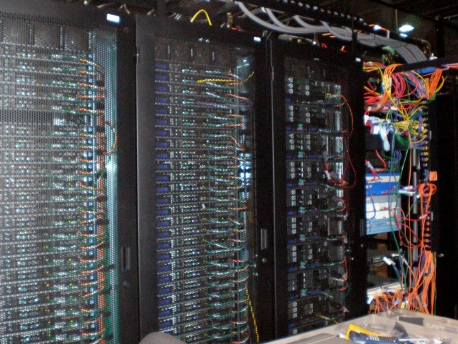
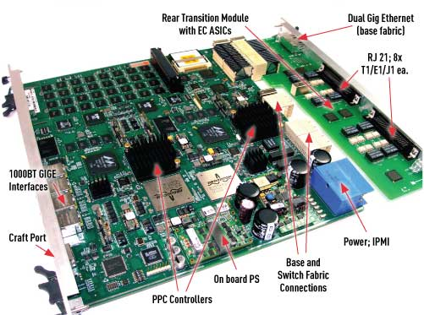
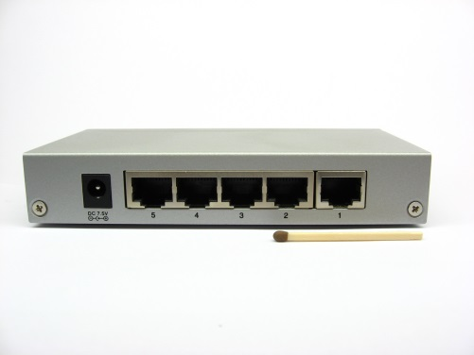
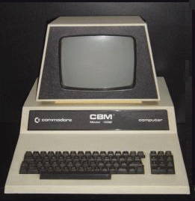
What is missing in the picture
Behavioral Description
src=1.2.*.*, dest=3.4.5.* → drop
src = *.*.*.*, dest=3.4.*.* → forward(2)
src=10.1.2.3, dest=*.*.*.* → send to controller
«generic» forwarding device
«repurposed» device
OF forwarding abstraction insufficient!!
Platform-agnostic stateful processing: how to?
Any vendor, any size, any HW/SW platform…

Slide 51
Easier said than done
We need a switch architecture and API which is…
High performance: control tasks executed at wire-speed (packet-based events)
Platform-independent: consistent with vendors’ needs for closed platforms
Low cost and immediately viable: based on commodity HW
Apparently, far beyond OpenFlow switches…
Our (perhaps surprising?) finding: much closer to OF than expected!!

Slide 52
Our findings at a glance
Any control program that can be described by a Mealy (Finite State) Machine is already (!) compliant with OF1.3
MM + Bidirectional flow state handling requires minimal hardware extensions to OF1.1+
Proof of concept HW and SW implementation

Slide 53
Our approach: OpenState easier understood via a running example: port knocking
[CCR14] G. Bianchi, M. Bonola, A. Capone, C. Cascone, “OpenState: programming platform-independent stateful OpenFlow applications inside the switch”, ACM Computer Communication Review, vol. 44, no. 2, April 2014.
[ARX14] G. Bianchi, M. Bonola, A. Capone, C. Cascone, S. Pontarelli, “Towards Wire-speed Platform-agnostic Control of OpenFlow Switches”, available on ArXiv, 2014.

Slide 54
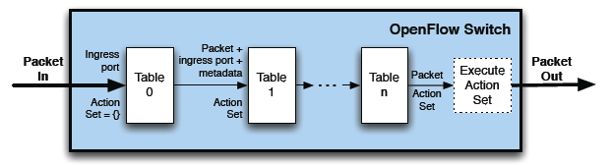
Remember OF match/action API
Programmabile logic
Vendor-implemented
Matching
Rule
Action
FORWARD TO PORT
ENCAPSULATE&FORWARD
DROP
…
Extensible
Pre-implemented matching engine
Switch
Port
MAC
src
MAC
dst
Eth
type
VLAN
ID
IP
Src
IP
Dst
IP
Prot
TCP
sport
TCP
dport
Multiple flow tables
since OF version 1.1

Slide 55
Background: Port Knocking firewall knock «code»: 5123, 6234, 7345, 8456
IPsrc=1.2.3.4
Port=5123
Drop(); 1.2.3.4 → 1° knock OK
IPsrc=1.2.3.4
Port=6234
Drop(); 1.2.3.4 → 2° knock OK
IPsrc=1.2.3.4
Port=7345
Drop(); 1.2.3.4 → 3° knock OK
IPsrc=1.2.3.4
Port=8456
Drop(); 1.2.3.4 → OPEN port SSH
IPsrc=1.2.3.4
Port=22
Forward()

Slide 56
Port Knocking @ controller
DROP
IPsrc=any
Port=any
When knock sequence
finalized, add entry
<Ipsrc, port=22; forward>
Encapsulate & forward ALL packets of ALL flows
IPsrc=any
Port=any
controller
Lots of overhead!!
Needed as no «knock» state handled in switch
Maintain Knock state per flow

Slide 57
«Abstract» description for port knocking: Mealy Machine
Port!=5123
Drop()
Port=5123
Drop()
Port=6234
Drop()
Port=7345
Drop()
Port=8456
Drop()
Port=22
Forward()
DEFAULT
Stage 1
Stage 2
Stage 3
OPEN
Port!=6234
Drop()
Port!=7345
Drop()
Port!=8456
Drop()
Port!=22
Drop()

Slide 58
Can transform in a flow table? Yes: MATCH: <state, port> → ACTION: <drop/forward, state_transition> Plus a state lookup/update
Ipsrc: ??
State DB
Metadata: State-label
IPsrc
Port
Match fields
Actions
state
event
action
Next-state
DEFAULT
Port=5123
drop
STAGE-1
STAGE-1
Port=6234
drop
STAGE-2
STAGE-2
Port=7345
drop
STAGE-3
STAGE-3
Port=8456
drop
OPEN
Ipsrc→OPEN
OPEN
Port=22
forward
OPEN
OPEN
Port=*
drop
OPEN
State DB
*
Port=*
drop
DEFAULT

Slide 59
Putting all together
1) State lookup
2) XFSM state transition
IPsrc=1.2.3.4
Port=8456
STAGE-3
IPsrc=1.2.3.4
Port=8456
State Table
XFSM Table
Flow key
state
Match fields
Actions
IPsrc= … …
… … …
state
event
action
Next-state
Ipsrc= … …
… … …
DEFAULT
Port=5123
drop
STAGE-1
IPsrc=1.2.3.4
Write: OPEN
STAGE-3
STAGE-1
Port=6234
drop
STAGE-2
IPsrc=5.6.7.8
OPEN
STAGE-2
Port=7345
drop
STAGE-3
IPsrc= … …
… … …
STAGE-3
Port=8456
drop
OPEN
IPsrc= no match
DEFAULT
OPEN
Port=22
forward
OPEN
write
OPEN
Port=*
drop
OPEN
*
Port=*
drop
DEFAULT
3) State update
OPEN
1 «program» XFSM table for all flows
(same knocking sequence)
N states, one per (active) flow
IPsrc=1.2.3.4
Port=8456

Slide 60
Proof of concept
SW implementation:
Trivial modifications to SoftSwitch
Public domain
HW implementation:
5 clock (2 SRAM read + 2 TCAM + 1 SRAM write)
10 Gbps just requires 156 MHz clock TCAM, trivial
Optimization in progress (pipelining) for 100 Gbps.

Slide 61
Cross-flow state handling
Yes but what about MAC learning, multi-port protocols (e.g., FTP), bidirectional flow handling, etc?
State Table
MACdst
MACsrc
lookup
Flow key
state
48 bit MAC addr
Port #
XFSM Table
state
event
action
Next-state
Port#
*
forward
In-port
State Table
MACdst
MACsrc
update
Flow key
state
48 bit MAC addr
Port #
DIFFERENT lookup/update scope
Field 1
Field 2
Field N
Flowkey selector
Read/write signal

Slide 62
Current challenge Prove programmability of complex functions
DONE:
Port Knocking
MAC learning
Label/address advertisement learning
Reverse Path Forwarding
Flow-consistent Load Balancing
DDoS multi-stage flow marking
…
CHALLENGE:
IDS/DPI
TCP flow processing
Monitoring
…
Need new «actions»
Need extra logic (full XFSM)
All (!) otherwise not possible without explicit controller’s involvement or custom distrib. control…
Our challenge: towards an open «flow processor»?

Slide 63
Aftermath
Control intelligence in devices seems possible
Via Platform-independent abstraction
Retaining high speed & scalability
As «small» OpenFlow extension (?!)
TCAM as «State Machine processor»
Now Mealy Machines
Currently working on full XFSM extension
Rethinking control-data plane SDN separation?
Control = Decide! Not decide+enforce!

Slide 64
Applied smartness: stateful applications
There are science and the applications of science, bound together as the fruit of the tree which bears it. [Louis Pasteur]

Slide 65
openstate-sdn.org
Switch: ofsoftswitch13; Controller: Ryu

Slide 66
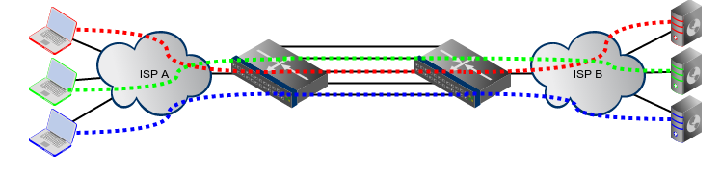
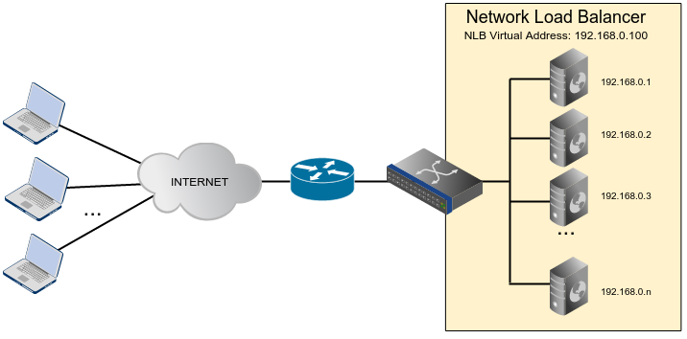
Forwarding Consistency
Ensure consistency in forwarding decisions for packets of a same transport layer flow
Example: LAG @Internet Exchange Point
Example: Server Load Balancer

Slide 67
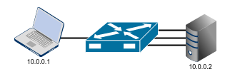
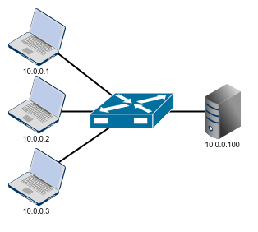
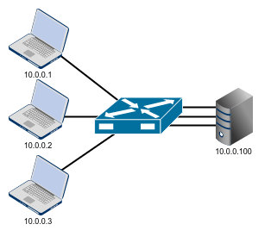
Forwarding Consistency
One to Many:
Intra-flow state handling
Many to One:
Cross-flow state handling
Many to Many:
Inter-stage cross-flow state handling

Slide 68
Forwarding Consistency: One to Many
The first packet of a TCP connection coming from the input port is sent to one of many possible output ports.
All the next packets of the same TCP connection must be forwarded on the same selected port.

Slide 69
Forwarding Consistency: One to Many
OpenFlow solution: the controller is in charge of states management.
controller
First packet of each new TCP connection is sent to the controller in order to:
-select an output port (e.g. randomly) and forward the packet
-install a flow entry for subsequent packets

Slide 70
Forwarding Consistency: One to Many
OpenState solution:
the switch itself handles connection’s state.
A flow is identified by [IP_SRC,IP_DST,TCP_SRC,TCP_DST]
FLOW STATE: output port
First packet of each new TCP connection is sent to the Group Table in order to:
select an output port randomly
store the selected port in the State Table for subsequent packets
Controller is not involved!

Slide 71
Forwarding Consistency: One to Many
In this case the state is set in the group table
Random Group Entry
Lookup Scope: IP_src, IP_dst, TCP_src,TCP_dst
Update Scope: IP_src, IP_dst, TCP_src,TCP_dst
1) State lookup
2) XFSM state transition
IP_src=10.0.0.1
IP_dst=10.0.0.2
TCP_src=2500
TCP_dst=80
DEFAULT
IP_src=10.0.0.1
IP_dst=10.0.0.2
TCP_src=2500
TCP_dst=80
State Table
XFSM Table
Flow key
State
Match fields
Actions
IP_src=10.0.0.1
IP_dst=10.0.0.2
TCP_src=1000
TCP_dst=80
1
state
event
action
… …
… …
… …
… …
… …
IP_src=10.0.0.1
IP_dst=10.0.0.2
TCP_src=2500
TCP_src=80
2
DEF.
In-port=1
Group(1)
IP_src=10.0.0.1
IP_dst=10.0.0.2
TCP_src=3000
TCP_dst=80
3
1
In-port=1
Forward(2)
*
*
*
*
DEFAULT
2
In-port=1
Forward(3)
3
In-port=1
Forward(4)
*
In-port=2
Forward(1)
write
*
In-port=3
Forward(1)
4) State update
*
In-port=4
Forward(1)
Group Table
2
Group Entry
Buckets
#
action
Next-state
IP_src=10.0.0.1
IP_dst=10.0.0.2
TCP_src=2500
TCP_dst=80
Entry 1
Forward(2)
1
Forward(3)
2
Forward(4)
3

Slide 72
Forwarding Consistency: Many to One
Forwarding consistency must be ensured according to packets received in the reverse direction.
The first packet of a TCP connection coming from one of the many input ports is forwarded on the only output port.
All packets of the reverse flow of the same TCP connection must be forwarded on the same ingress port.

Slide 73
Forwarding Consistency: Many to One
OpenFlow solution:
the controller is in charge of states management.
controller
First packet of each new TCP connection is sent to the controller in order to:
-forward the packet
-install a flow entry for reverse flow’s packets

Slide 74
Forwarding Consistency: Many to One
OpenState solution:
the switch itself handles connection’s state.
A flow is identified by [IP_SRC,IP_DST,TCP_SRC,TCP_DST]
FLOW STATE: input port
First packet of each new TCP connection is forwarded and the input port is stored to forward response packets
Cross-flow state
Controller is not involved!

Slide 75
Forwarding Consistency: Many to One
Communication Host -> Server
Lookup Scope: IP_src, IP_dst,TCP_src,TCP_dst
Update Scope: IP_dst,IP_src,TCP_dst,TCP_src
1) State lookup
2) XFSM state transition
IP_src=10.0.0.1
IP_dst=10.0.0.100
TCP_src=2500
TCP_dst=80
DEFAULT
IP_src=10.0.0.1
IP_dst=10.0.0.100
TCP_src=2500
TCP_dst=80
State Table
XFSM Table
Flow key
State
Match fields
Actions
IP_src=10.0.0.200
IP_dst=10.0.0.2
TCP_src=80
TCP_dst=1000
2
state
event
action
Next-state
… …
… …
… …
… …
… …
IP_src=10.0.0.100
IP_dst=10.0.0.1
TCP_src=80
TCP_dst=2500
1
1
In-port=4
Forward(1)
-
… …
… …
… …
… …
… …
2
In-port=4
Forward(2)
-
*
*
*
*
DEFAULT
3
In-port=4
Forward(3)
-
*
In-port=1
Forward(4)
1
*
In-port=2
Forward(4)
2
write
*
In-port=3
Forward(4)
3
3) State update
1
IP_src=10.0.0.100
IP_dst=10.0.0.1
TCP_src=80
TCP_dst=2500
DIFFERENT lookup/update scope
IP_src=10.0.0.1
IP_dst=10.0.0.100
TCP_src=2500
TCP_dst=80

Slide 76
Forwarding Consistency: Many to One
Communication Server -> Host
Lookup Scope: IP_src, IP_dst,TCP_src,TCP_dst
Update Scope: IP_dst,IP_src,TCP_dst,TCP_src
1) State lookup
2) XFSM state transition
IP_src=10.0.0.100
IP_dst=10.0.0.1
TCP_src=2500
TCP_dst=80
1
IP_src=10.0.0.1
IP_dst=10.0.0.100
TCP_src=2500
TCP_dst=80
State Table
XFSM Table
Flow key
State
Match fields
Actions
IP_src=10.0.0.200
IP_dst=10.0.0.2
TCP_src=80
TCP_dst=1000
2
state
event
action
Next-state
IP_src=10.0.0.100
IP_dst=10.0.0.1
TCP_scr=80
TCP_dst=2500
1
1
In-port=4
Forward(1)
-
… …
… …
… …
… …
… …
2
In-port=4
Forward(2)
-
*
*
*
*
DEFAULT
3
In-port=4
Forward(3)
-
*
In-port=1
Forward(4)
1
*
In-port=2
Forward(4)
2
*
In-port=3
Forward(4)
3

Slide 77
Forwarding Consistency: Many to Many
Combining the first two, we want here to load balance on the output ports while doing reverse path forwarding on the input port
The first packet of a TCP connection coming from one of the many input ports is forwarded to one of many possible output ports.
All the next packets of the same TCP connection must be forwarded on the same selected output port, while all packets of the reverse flow of the same TCP connection must be forwarded on the same ingress port.

Slide 78
Forwarding Consistency: Many to Many
OpenState solution
A flow is identified by [IP_SRC,IP_DST,TCP_SRC,TCP_DST]
Two states are needed for each bidirectional flow:
FLOW STATE 1: output port
FLOW STATE 2: input port
For each first packet of each new TCP connection:
packet is forwarded to a random output port
the selected output port is stored in the State Table 0
the input port is stored in the State Table 1

Slide 79
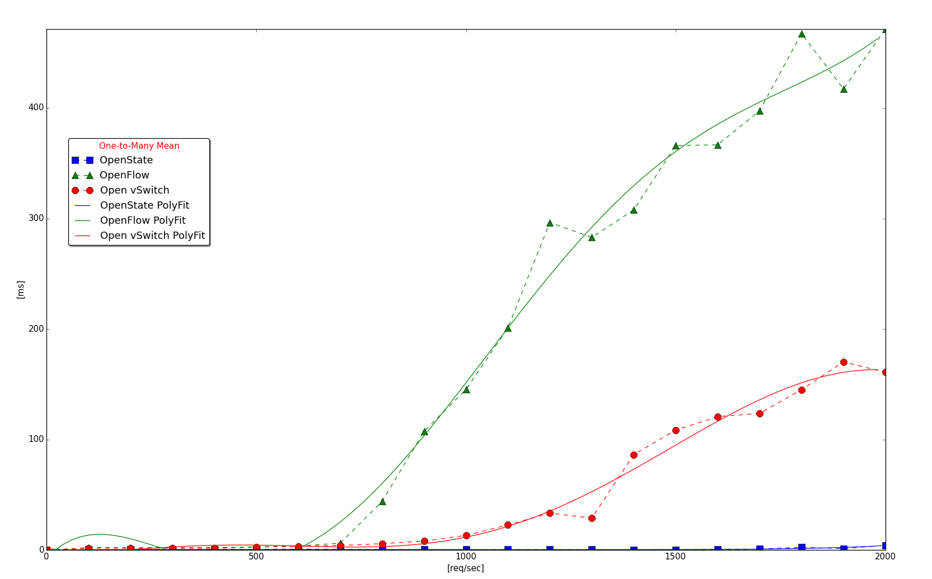
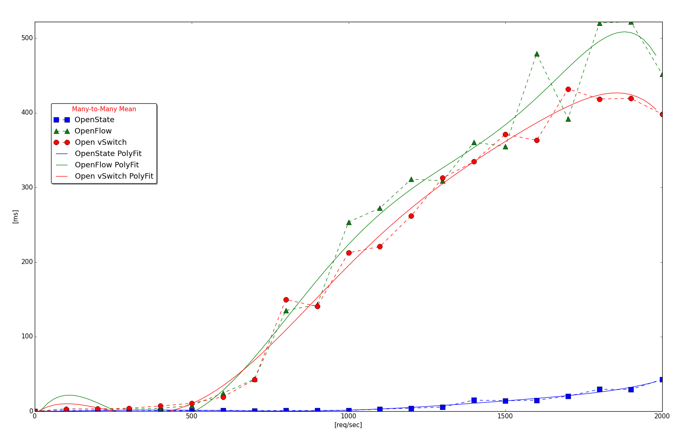
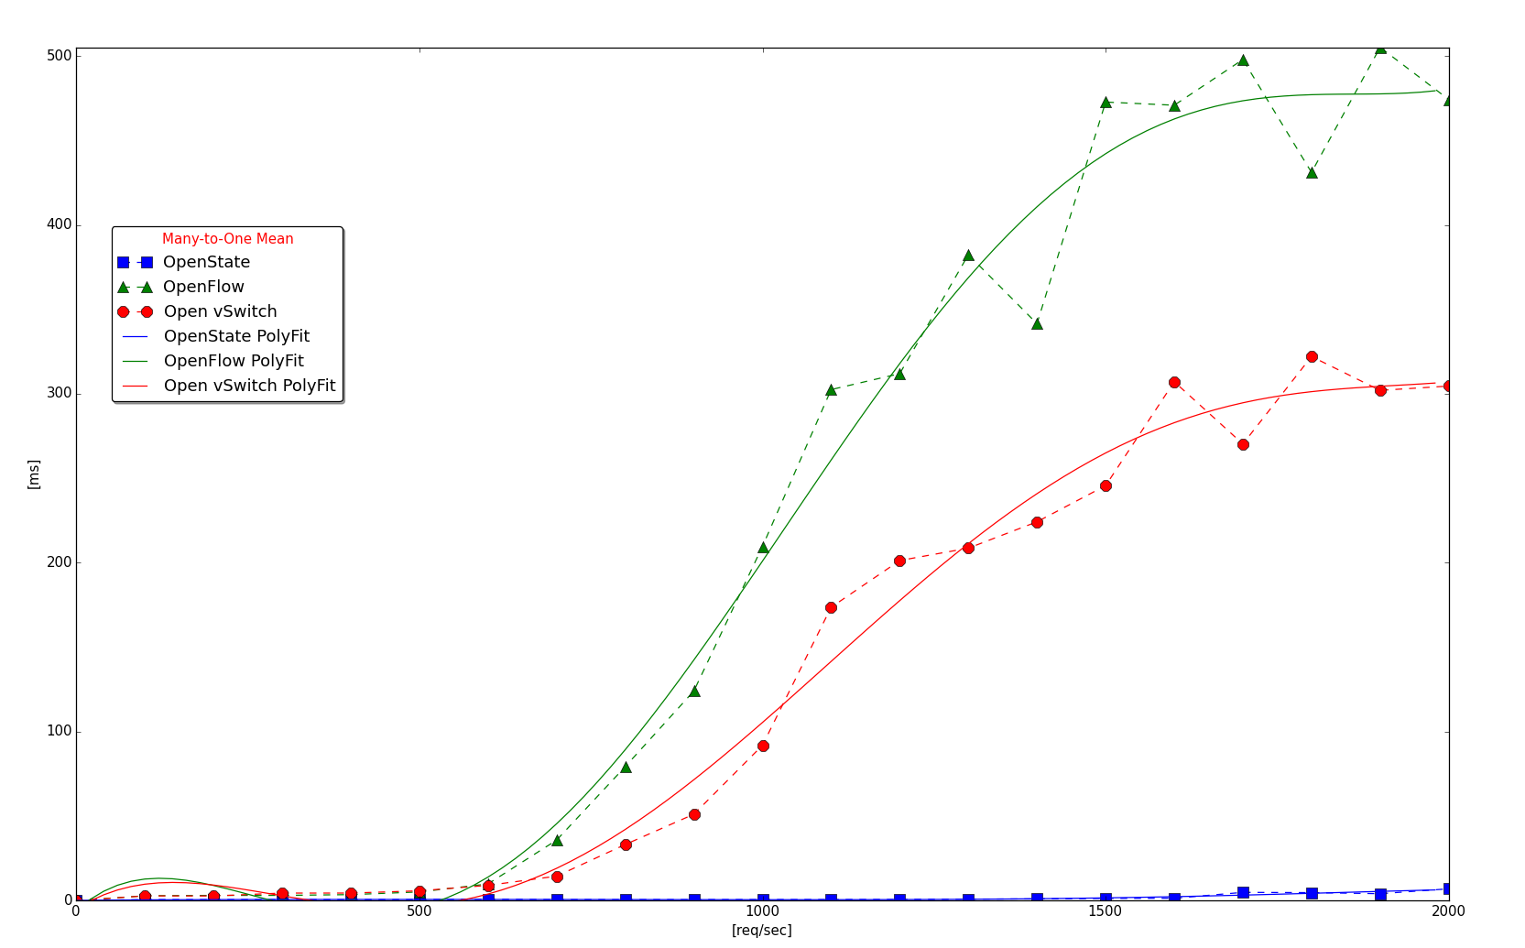
Forwarding Consistency: Example Results
Results will show the average value of the time required by 1000 TCP SYN packets to cross the switches at increasing rate.
One-to-Many
Many-to-Many
OpenFlow
ofsoftswitch13
Many-to-One
OpenFlow
ofsoftswitch13
OpenFlow
Open Vswitch
OpenFlow
Open Vswitch
OpenFlow
ofsoftswitch13
OpenState
ofsoftswitch13
OpenFlow
Open Vswitch
OpenState
ofsoftswitch13
OpenState
ofsoftswitch13
Switch: ofsoftswitch13; Controller: Ryu

Slide 80
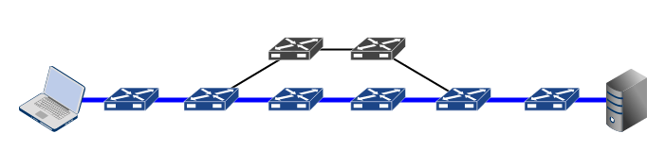
Fault Tolerance
Ensure the network failure resiliency, quickly readapting the routing after a failure
Fundamental function in any network (telco operators, data centers)
Weak support in OpenFlow

Slide 81
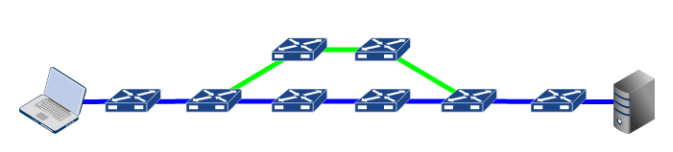
Fault Tolerance
OpenFlow
Fast failover: local reroute based on port states (Group table)
But what if a local reroute in not available ???

Slide 82
Fault Tolerance
OpenFlow
controller
Obviously it is always possible to rely on the controller to:
forward the packet on the backup path
install flow entries for the backup path

Slide 83
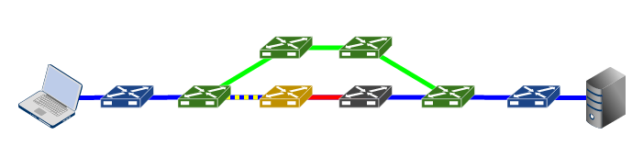
Fault Tolerance in OpenState
With OpenState the switch itself can react to the fault
PKT
TAG
PKT
Proposed solution:
Faults are signaled using the same data packets
Packets are tagged and sent back
Packets are sent back until matched against a node able to respond to that fault

Slide 84
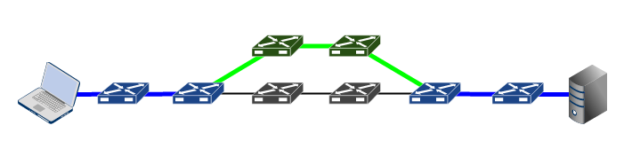
Fault Tolerance
OpenState
A DETOUR is enabled based on the specific failure without constraints
Backup paths can be pre-computed and installed by the controller (traffic engineering and quality/congestion control)
The controller is entitled to restore the primary path once the fault has been resolved
[CAP14] A. Capone, C. Cascone, A. Nguyen, B. Sansò, “Detour Planning for Fast and Reliable Failure Recovery in SDN with OpenState”, available on ArXiv, Nov. 2014.

Slide 85
Fault Tolerance: Fault Reaction Example
OpenState
STATE
TRANSITION!
FLAG SETUP
PKT
TAG
PKT
TAG
PKT
PKT
TAG
TAG
PKT
PKT
PKT
PKT
PKT
Fault_ID=20
Redirect Node:
FLOW STATE = DEF
Detect Node:
GLOBAL REGISTERS = 00
20
01
TAG = STATE = 20
TAG = FAULT_ID = 20
DEF
20
DEF
20
i

Slide 86
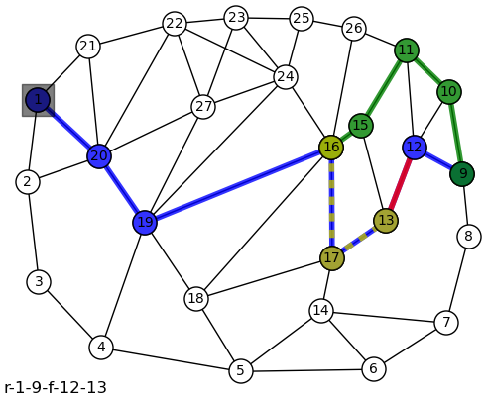
Fault Tolerance: Example on larger network
19
Primary node
13
Detect node
17
Forward-back node
16
Redirect node
15
Detour node

Slide 87
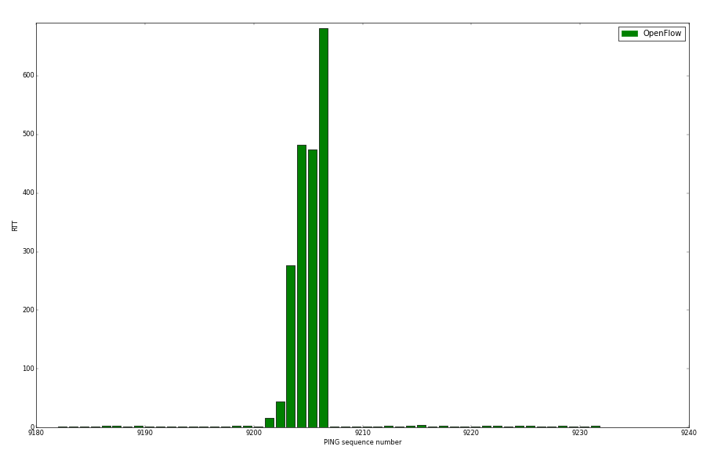
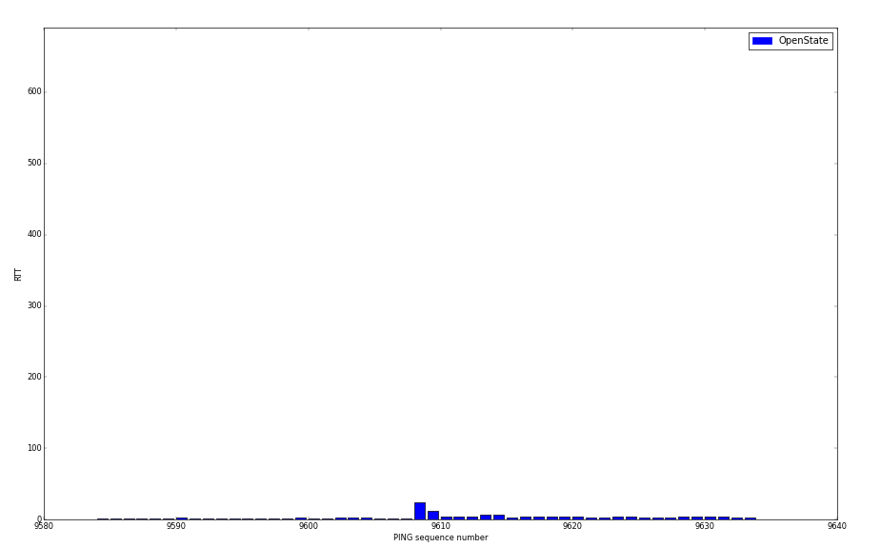
Fault Tolerance: Exampe Results
OpenFlow:
Controller applications
OpenState:
Precomputed backup paths

Slide 88
Thanks
Giuseppe Bianchi
Email: giuseppe.bianchi@uniroma2.it
Antonio Capone
Email: antonio.capone@polimi.it
OpenState: openstate-sdn.org
EU project BEBA (web site available soon) – follow us!
This slide-set soon available on OpenState web site!

